Slide 1
LEAVEFLOW
Employee Leave Management System
Project Focus
Leave application • approval • balances • holidays • calendar • email notifications

Slide 2
Project Overview
Problem
Objectives
Manual leave handling can make requests, approvals, balances and history difficult to track in one place.
LeaveFlow centralizes these activities in a role-based web application.
• Employees can apply and track leave
• Managers can approve or reject requests
• Admins can manage employees, balances and holidays
• Leave history and calendar are available
• Email notifications connect important events

Slide 3
User Roles & Responsibilities
Employee
Manager
Admin
Register / login
Apply for leave
View history
View balances
View calendar
Cancel pending leave
Login
View pending requests
Approve / reject leave
Review requests
Email employee after decision
Manage employees/managers
View employee details
Manage leave balances
Add/delete holidays

Slide 4
System Architecture
Frontend
Backend
Database
Services
HTML5
CSS3
JavaScript
Role-based pages
Fetch API
Python
FastAPI
REST APIs
JWT
Business logic
PostgreSQL
SQLAlchemy
Users
Leaves
Balances
Holidays
SMTP email
Password hashing
Calendar
Authorization

Slide 5
Technologies Used
Frontend
Backend
Database
HTML5 • CSS3 • JavaScript
Python
FastAPI
REST APIs
PostgreSQL
SQLAlchemy ORM
Security
Communication
Project Tools
JWT authentication
Passlib / bcrypt
Role-based authorization
SMTP
Email notifications
Leaflet/calendar UI

Slide 6
Main Workflow
STEP 1
STEP 2
STEP 3
STEP 4
Employee logs in
Applies for leave
Backend validates request
Request saved as Pending
STEP 5
STEP 6
STEP 7
STEP 8
Manager receives email
Manager approves / rejects
Employee receives email
Status / balance is reflected

Slide 7
Employee Leave Application Flow
POST /leave/
1. JWT identifies the employee
2. Validate start and end dates
3. Calculate number of days
4. Check overlapping pending/approved requests
5. Check current-year leave balance
6. Create LeaveRequest with status = "pending"
7. Commit request to PostgreSQL
8. Find active manager
9. Send manager notification through SMTP
10. Return created request

Slide 8
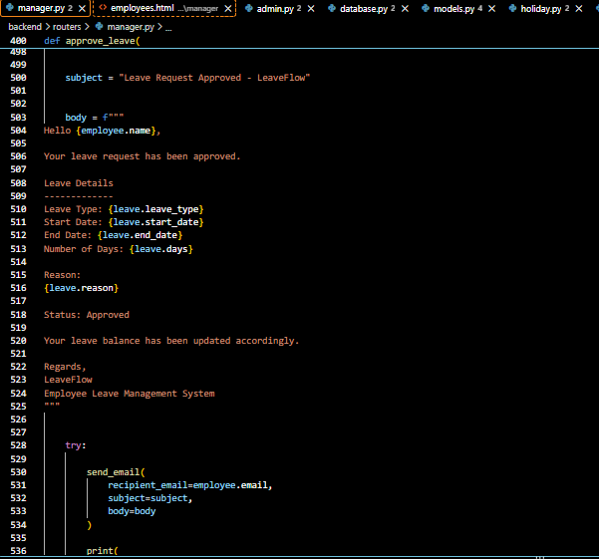
Code Highlight — Employee Notification

Slide 9
Database Design
Users
Leave Requests
Leave Balances
Holidays
id
name
email
password
role
is_active
created_at
id
user_id (FK)
leave_type
start_date
end_date
days
reason
status
id
user_id (FK)
leave_type
total_days
used_days
remaining_days
year
id
name
date
created_at

Slide 10
Authentication & Security
Registration
Login
Protected APIs
Password is hashed using bcrypt.
The plain password is not stored in the database.
Credentials are verified.
A JWT access token is generated and returned to the frontend.
Frontend sends:
Authorization: Bearer <token>
FastAPI validates the token and identifies the current user.

Slide 11
Email Notification Flow
1. Event
2. Backend
3. Recipient
Employee applies leave
Manager approves or rejects
FastAPI calls send_email()
Subject and body are created from leave details.
New request → Manager
Approval/rejection → Employee
SMTP delivers the message.

Slide 12
Admin Module
• Employee management — view employees and managers
• Employee details — leave overview, history and balances
• Leave balance management — view and update balances
• Holiday management — add and delete company holidays
• Role-based access protects administrative operations

Slide 13
Calendar & Holiday Integration
Employee Calendar
Holiday Integration
Displays the employee's pending and approved leave dates.
Leave data is fetched from the FastAPI calendar endpoint.
Company holidays are stored in PostgreSQL and exposed through a holiday API.
The frontend can display holidays alongside leave dates.

Slide 14
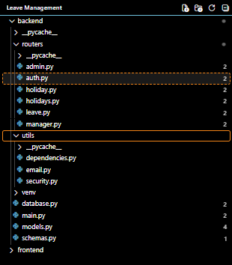
Backend Code Structure

Slide 15
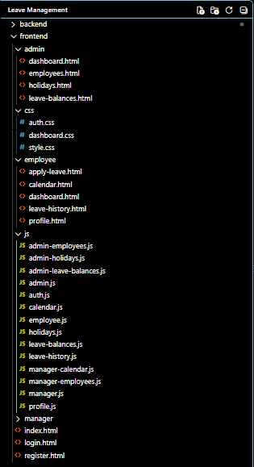
Frontend Code Structure

Slide 16
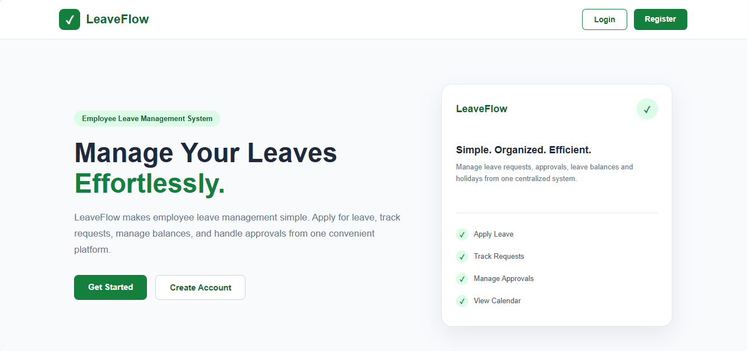
Application Screenshots & Output

Slide 17
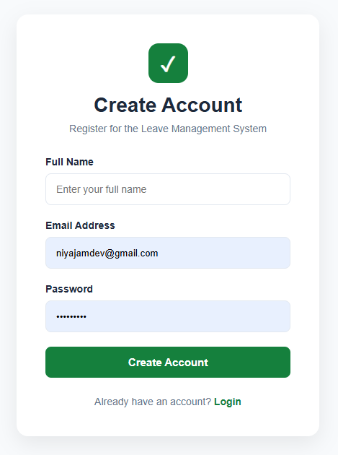
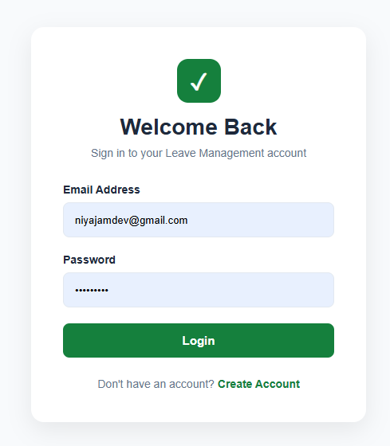

Slide 18
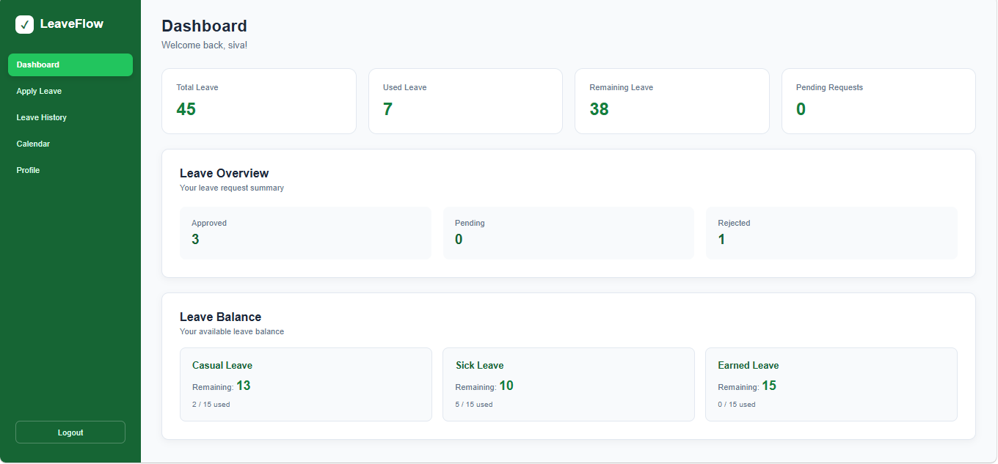
Employee’s -Dashboard

Slide 19
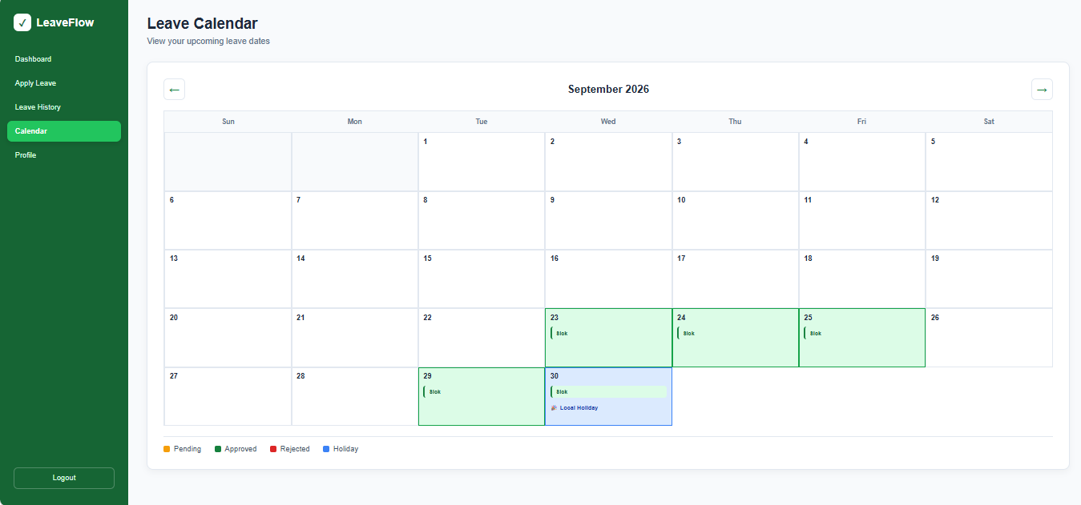

Slide 20
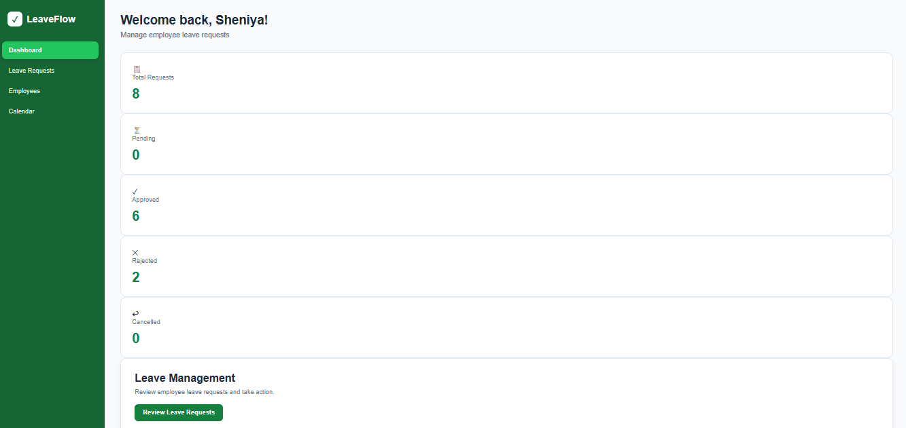
Manager’s Dashboard

Slide 21
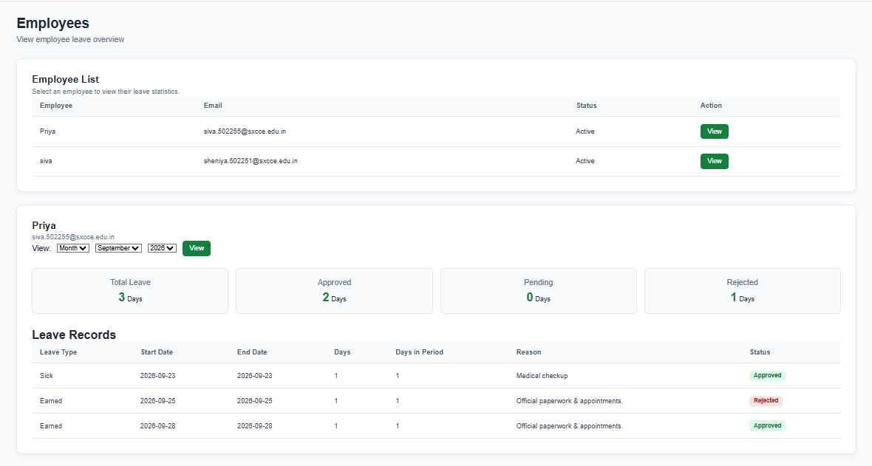
Admin’s Update Employee’s Leave Page

Slide 22
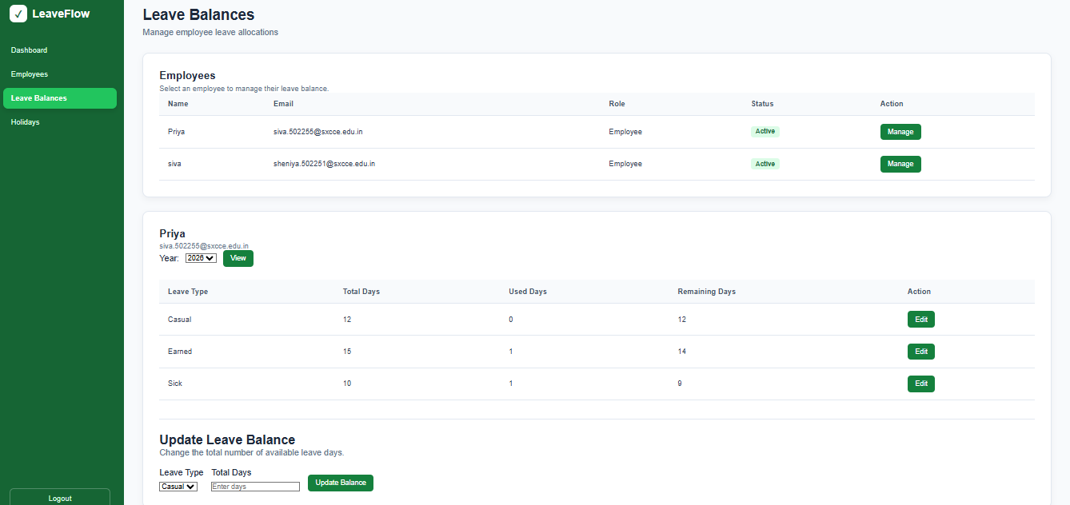

Slide 23
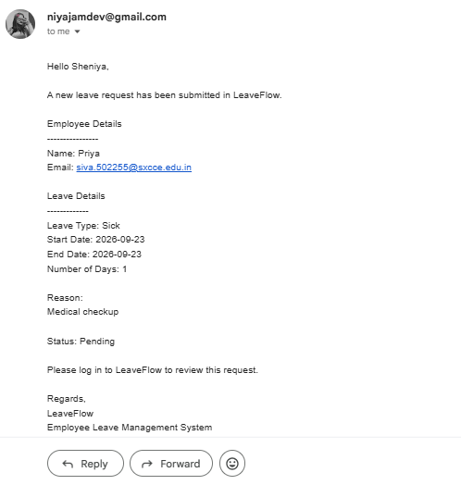
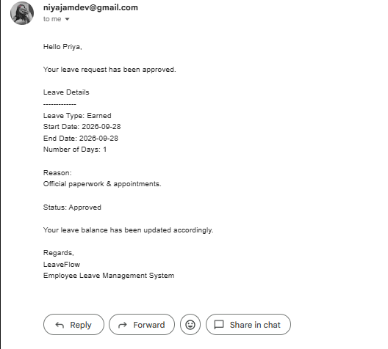
Output / Email Evidence

Slide 24
Validation & Testing
• Login and role-based access are checked before protected operations.
• End date cannot be before start date.
• Overlapping pending/approved leave requests are rejected.
• Leave balance is checked before a request is created.
• Only employees can apply for leave.
• Email failures are caught so the leave operation can still complete.

Slide 25
Additional Features Implemented
• Admin employee management and individual employee leave details
• Admin leave balance management
• Holiday management and holiday API
• Employee leave calendar
• JWT authentication and role-based authorization
• Password hashing with Passlib / bcrypt
• SMTP email notifications for leave events
• Leave cancellation for pending requests

Slide 26
Conclusion
To conclude, LeaveFlow provides a complete digital workflow for employee leave management.
Overall, the additional calendar, holiday and balance modules extend the basic leave management workflow into a more complete system
Thank You

